Slide 1
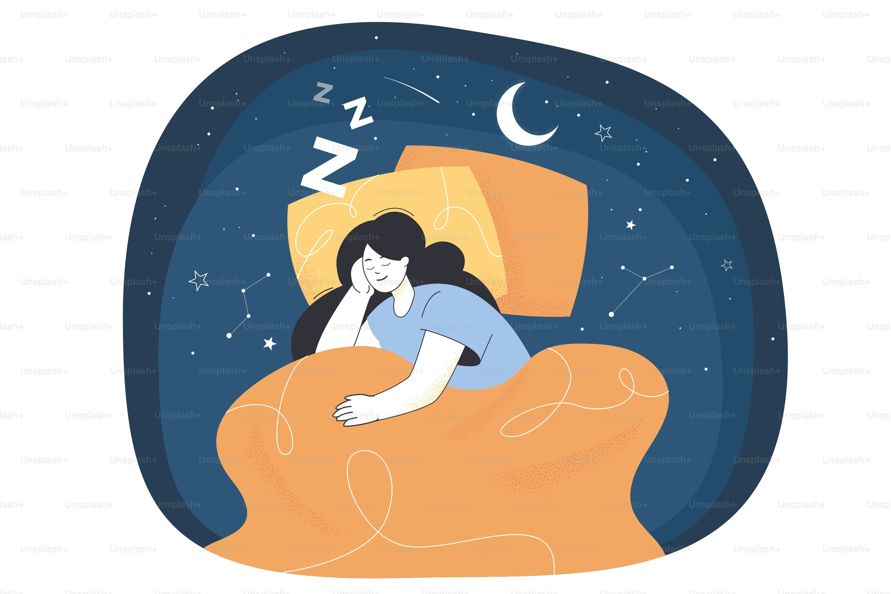
Sleep Disorder Factors
Group Project 4: Bradley Curthoys, Daniel Usuga, Bailey Strauch, Lisa Shimano

Slide 2
Dataset Summary
The Sleep Health and Lifestyle Dataset comprises 400 rows and 13 columns
Covers a wide range of variables related to sleep and daily habits
Includes details such as gender, age, occupation, sleep duration, sleep quality, physical activity level, stress level, BMI category, blood pressure, heart rate, daily steps and the presence or absence of sleep disorders.
The Sleep Health and Lifestyle Dataset was obtained from Kaggle, distributed under the Creative Commons Licence CC0: Public Domain. The data was synthetically created by the Author for illustrative purposes.
https://www.kaggle.com/datasets/uom190346a/sleep-health-and-lifestyle-dataset

Slide 3
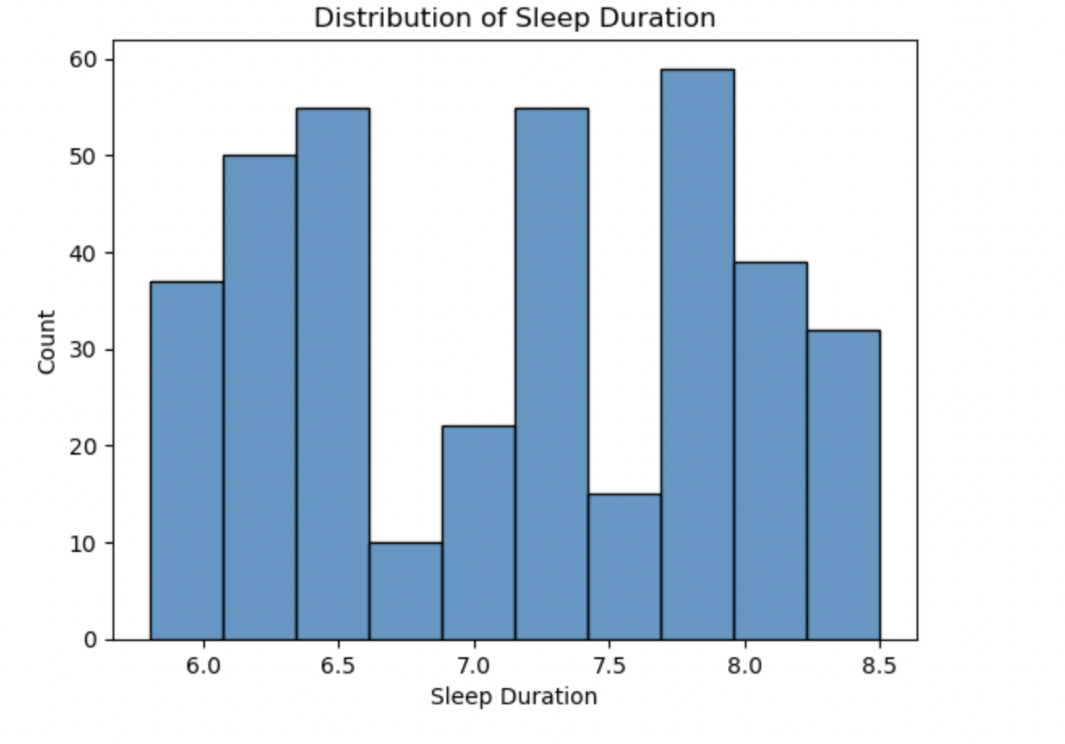
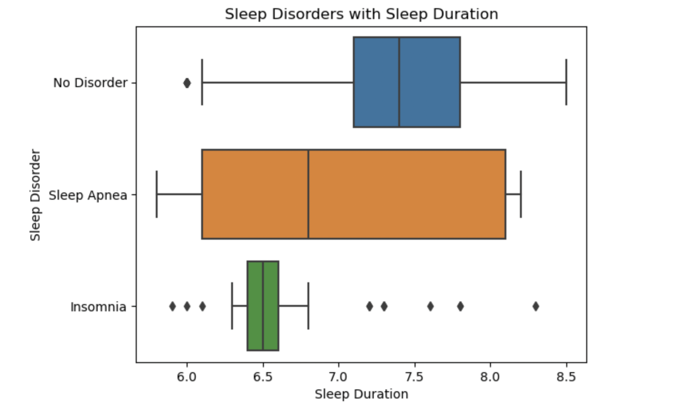
Graphs

Slide 4
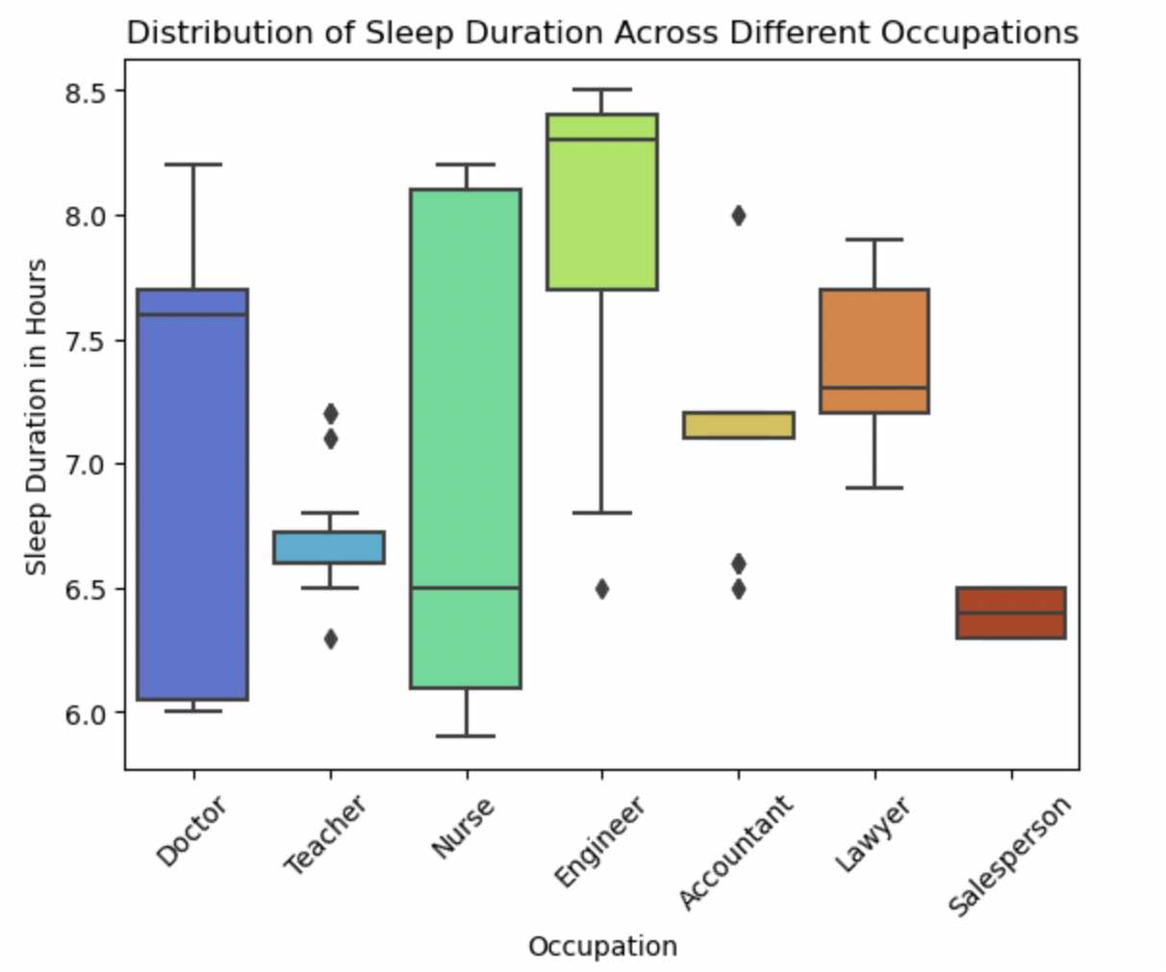
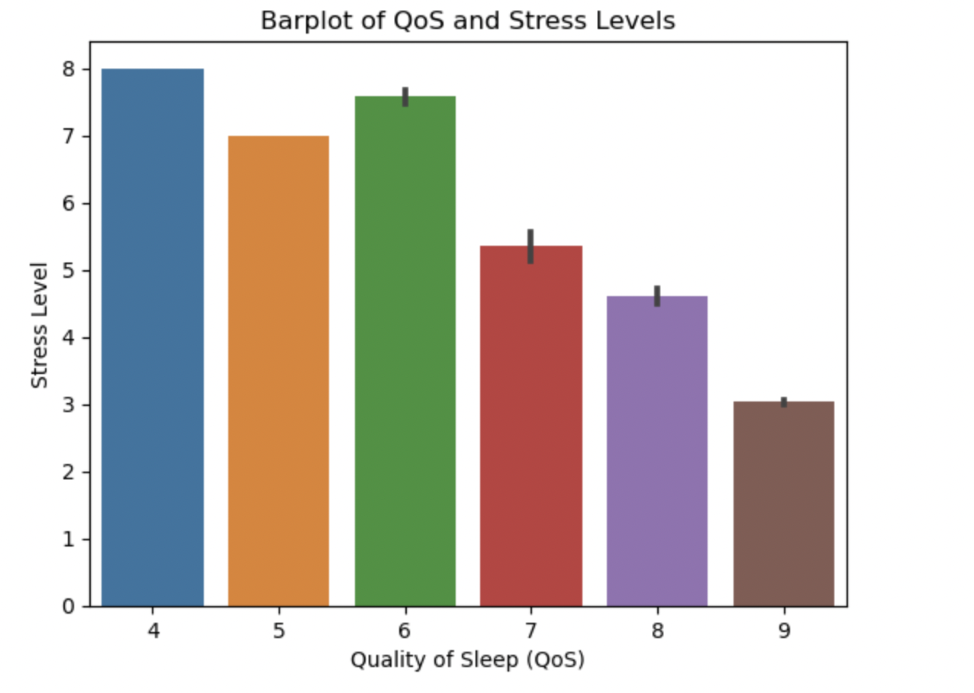

Slide 5
Machine Learning Model
Using Neural Networks to predict the presence of Sleep Disorders based on personal characteristics, daily activity and sleep/health habits

Slide 6
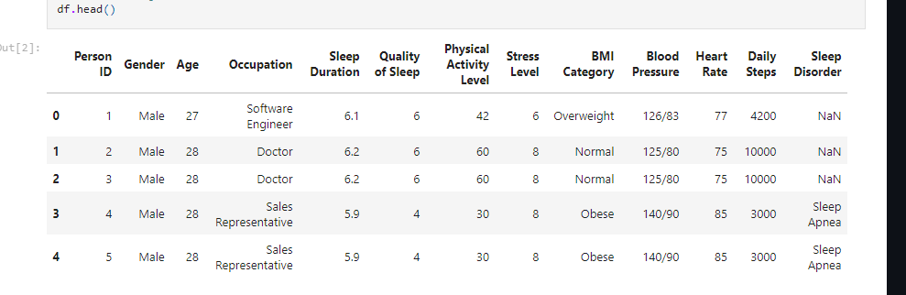
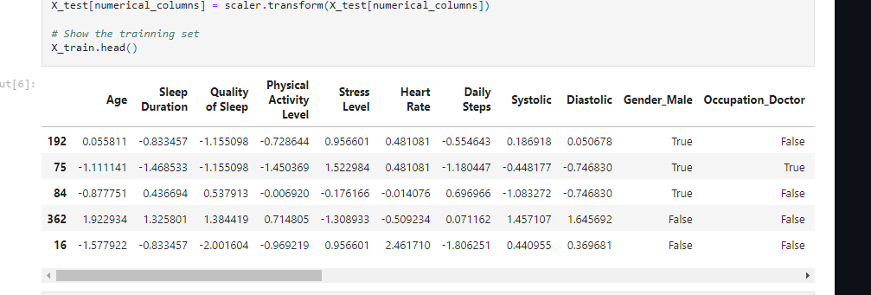
Data Preprocessing

Slide 7
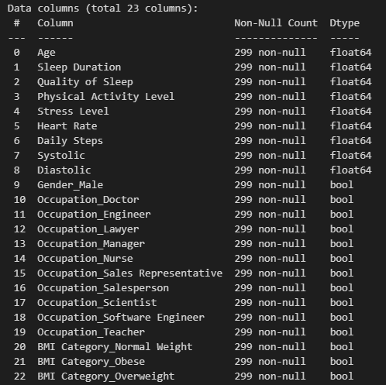
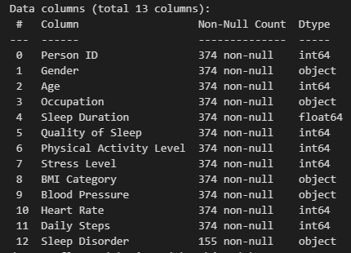
Data Preprocessing

Slide 8
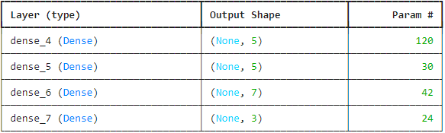
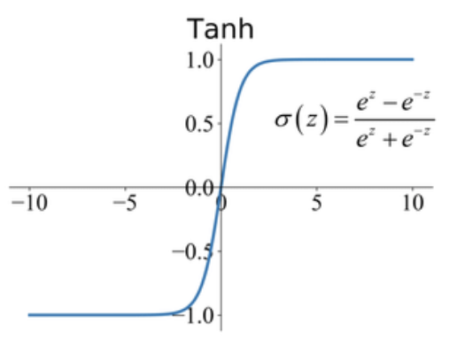
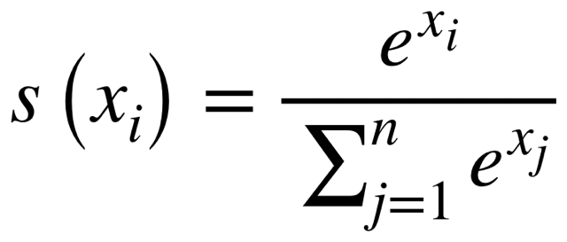
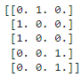
Neural Network Model Setup
The Tanh function was used as the main activation function for the model’s hidden layers
Output Variable
SoftMax
SoftMax function was used on the Output layer due to the Multiclass Classification Nature of the Model

Slide 9
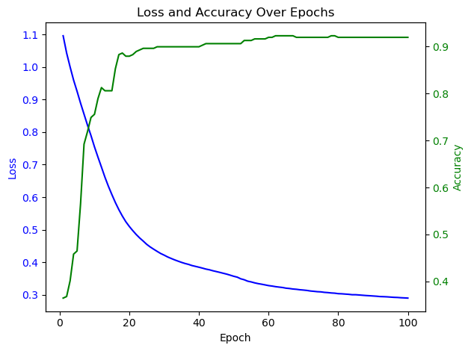
Model Training & Performance
Training Set
Accuracy: 0.9341
Loss: 0.2445
Test Set
Accuracy: 0.8933
Loss: 0.3969

Slide 10
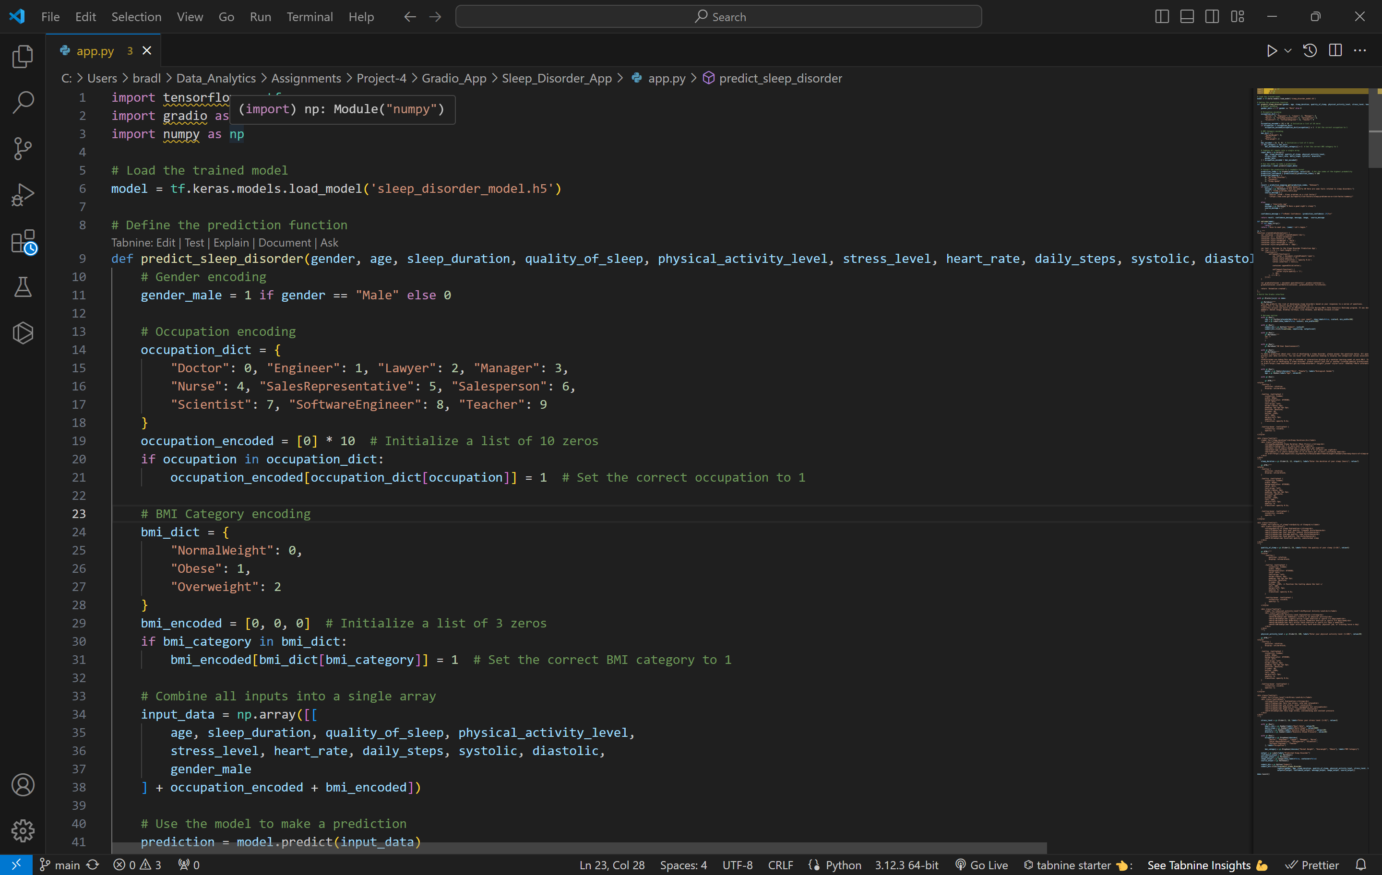
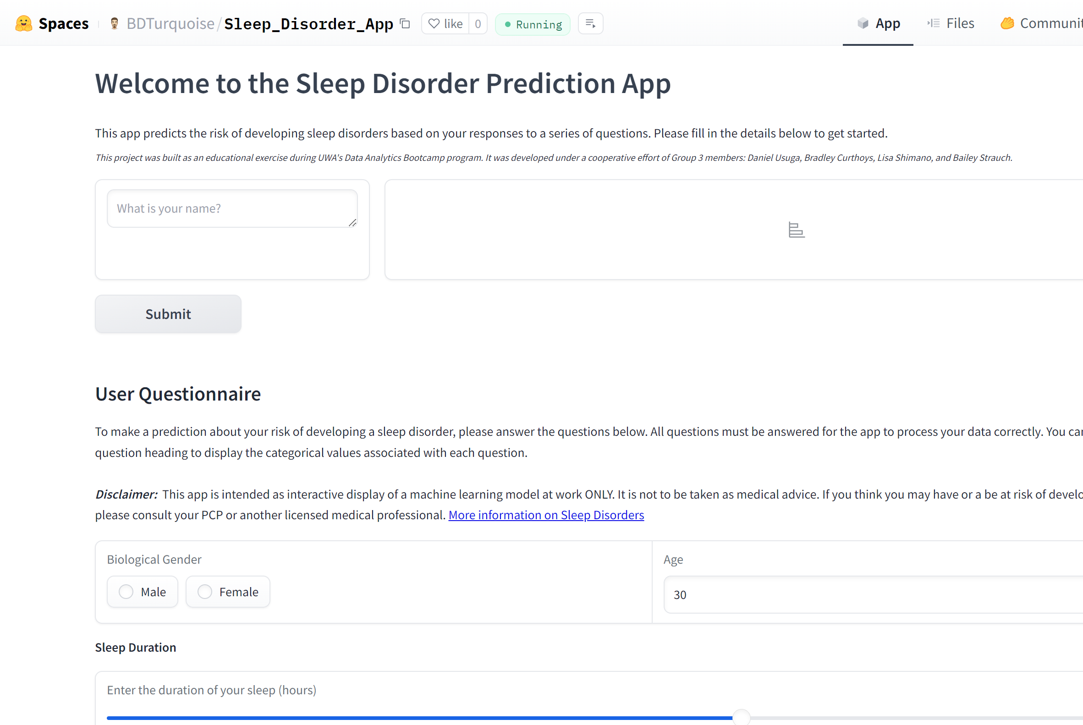
Gradio App

Slide 11
Gradio App
Machine learning prediction model loaded into Gradio – created user-friendly interface that makes interactive predictions
Python code uploaded model using HDF5 (Hierachical Data Format version 5) - combination of Markdown, HTML code, and conditional statements for integrated styling
Built interactivity with Gradio – based on user input, model makes prediction and displays confidence level
Supplemental information provided with a likelihood of sleep disorder
Hosted permanently via HuggingFace.co/Spaces
https://huggingface.co/spaces/BDTurquoise/Sleep_Disorder_App

Slide 12
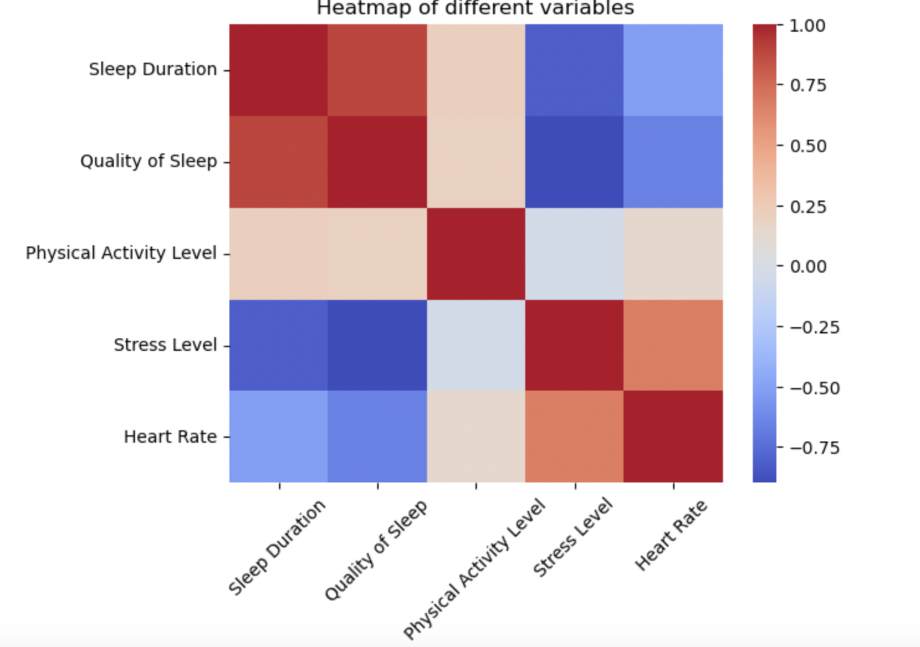
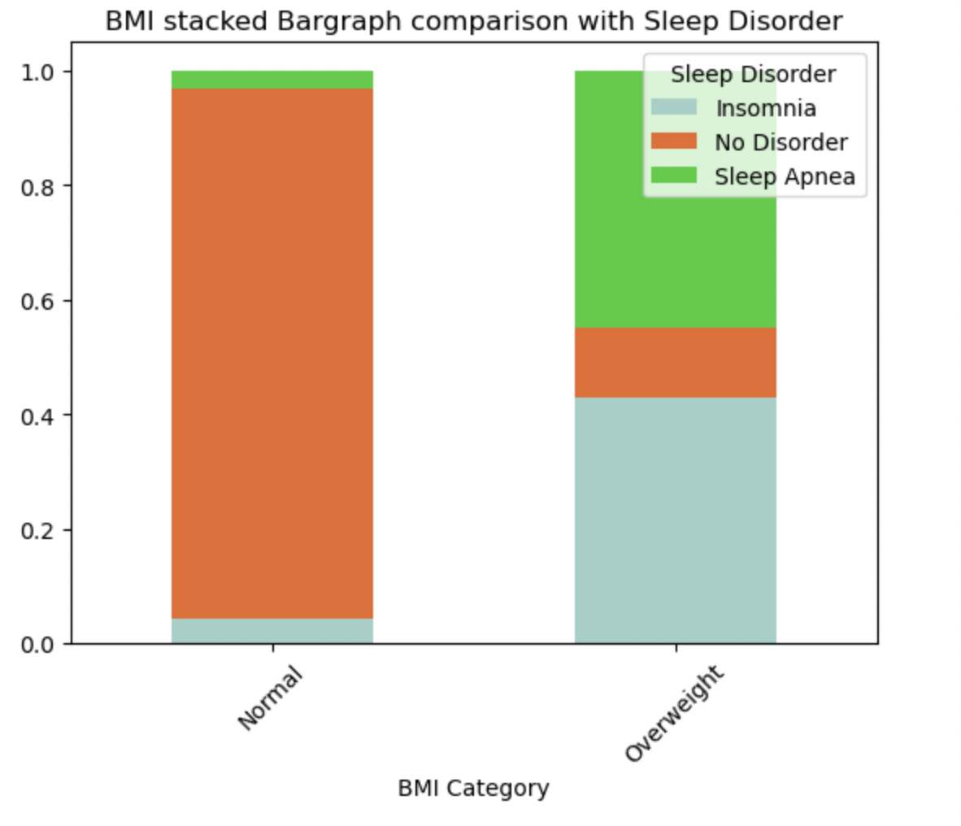
Summary of Overall Results
Sleep quality has strong correlation with sleep duration
Physical activity has not much effect
BMI has a strong impact on sleep disorders

Slide 13
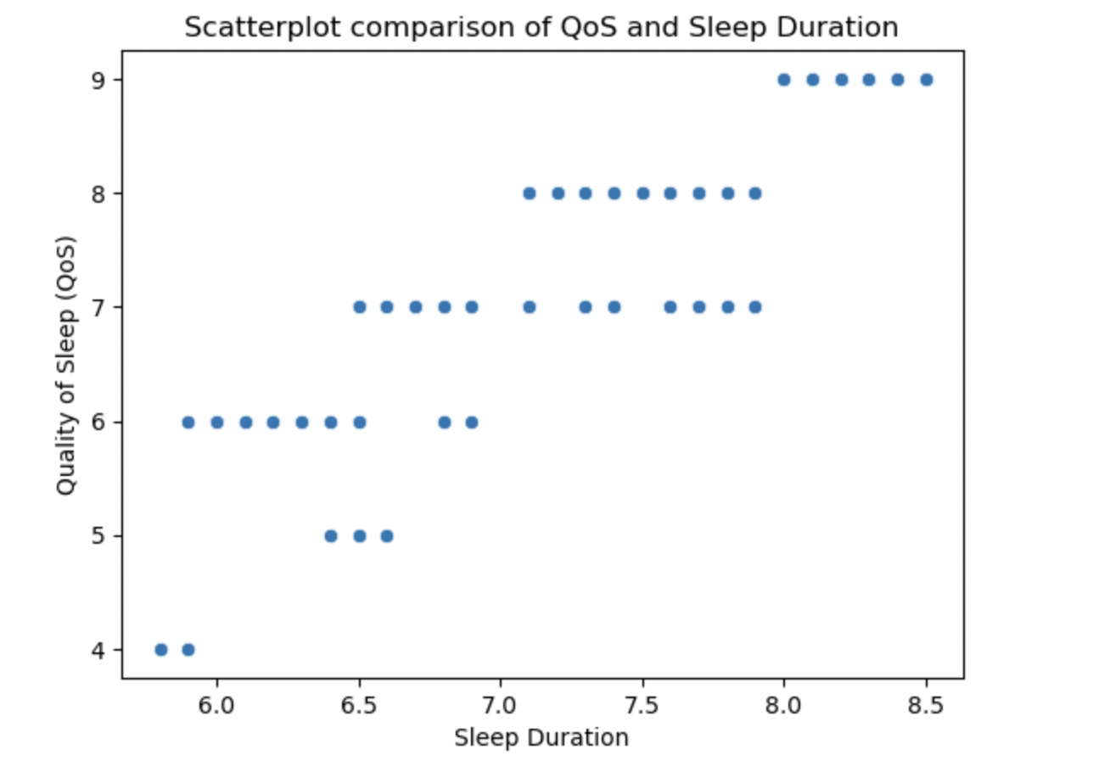
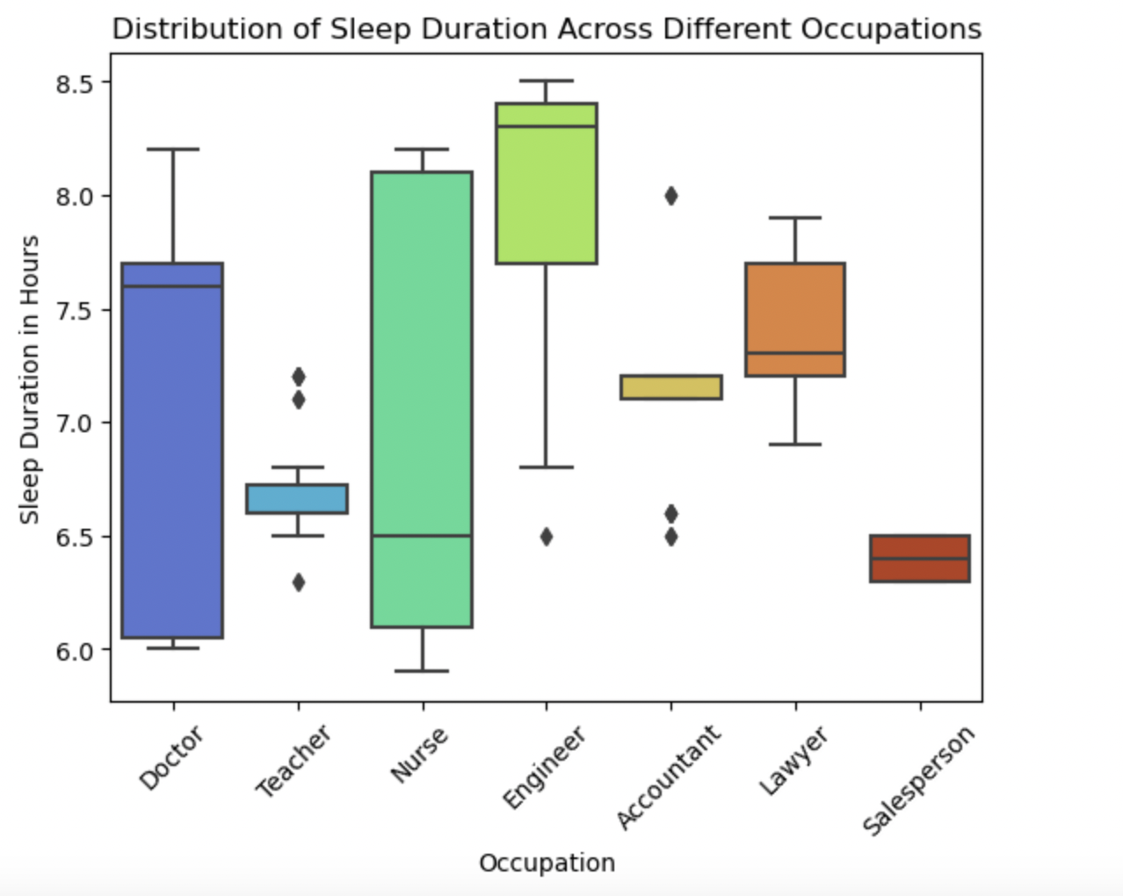
Limitations and Future Possibilities
Can be highly subjective/biased and depends on the individual
Examples to show limitations and subjectivity:

Slide 14

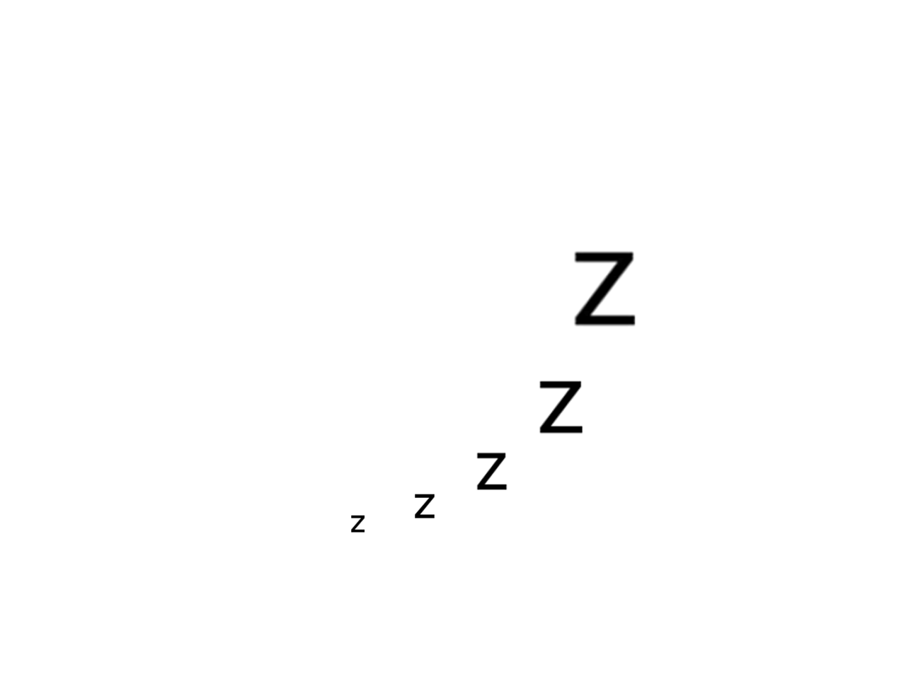
Thank you!

